Slide 1


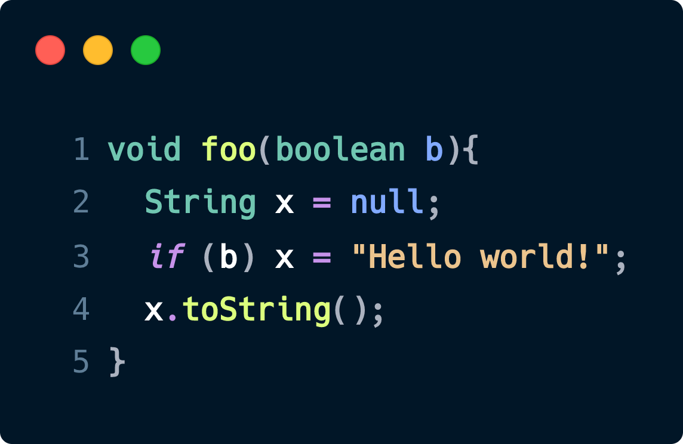
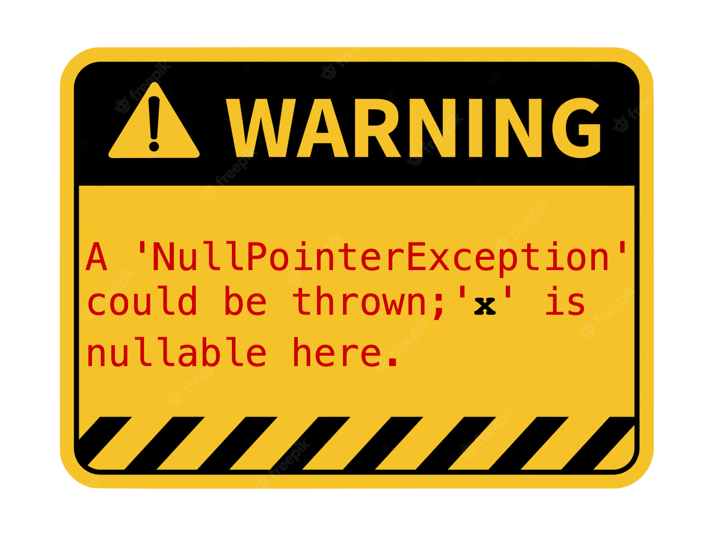





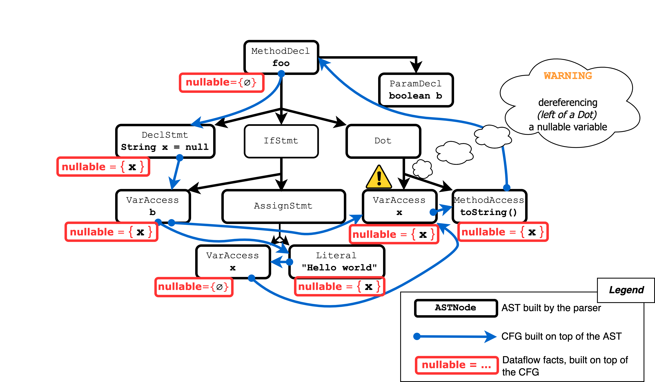
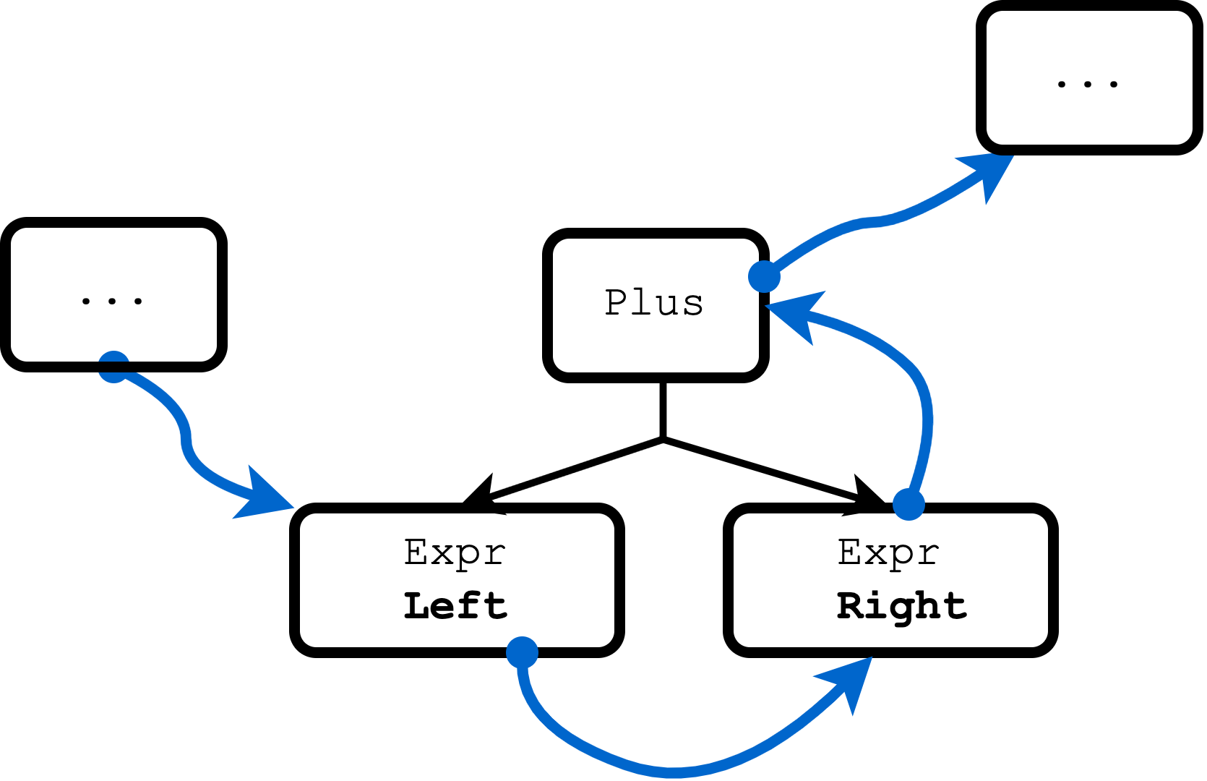
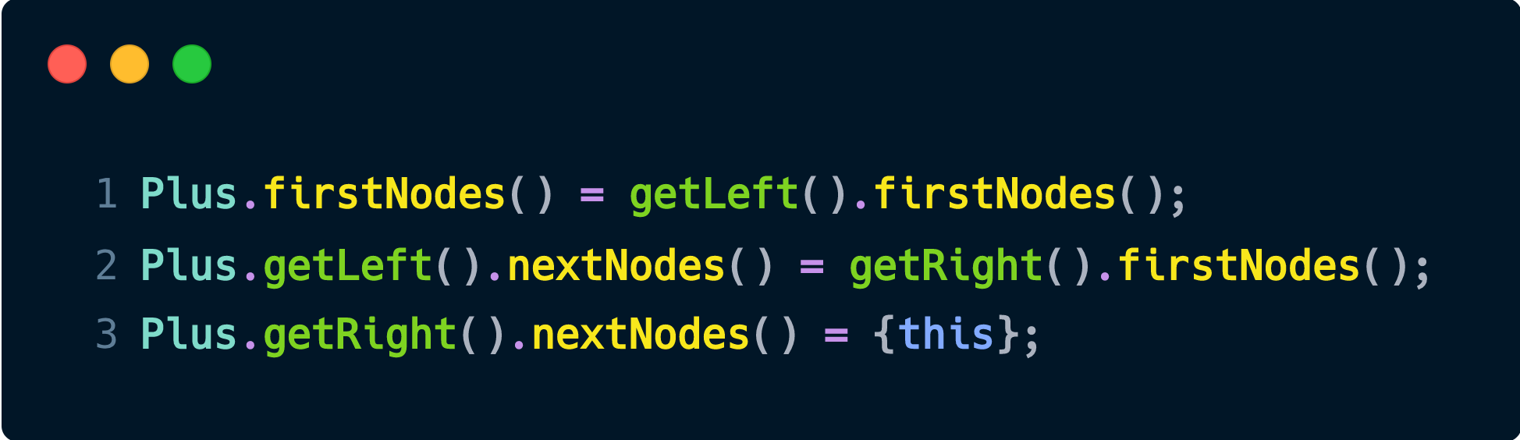
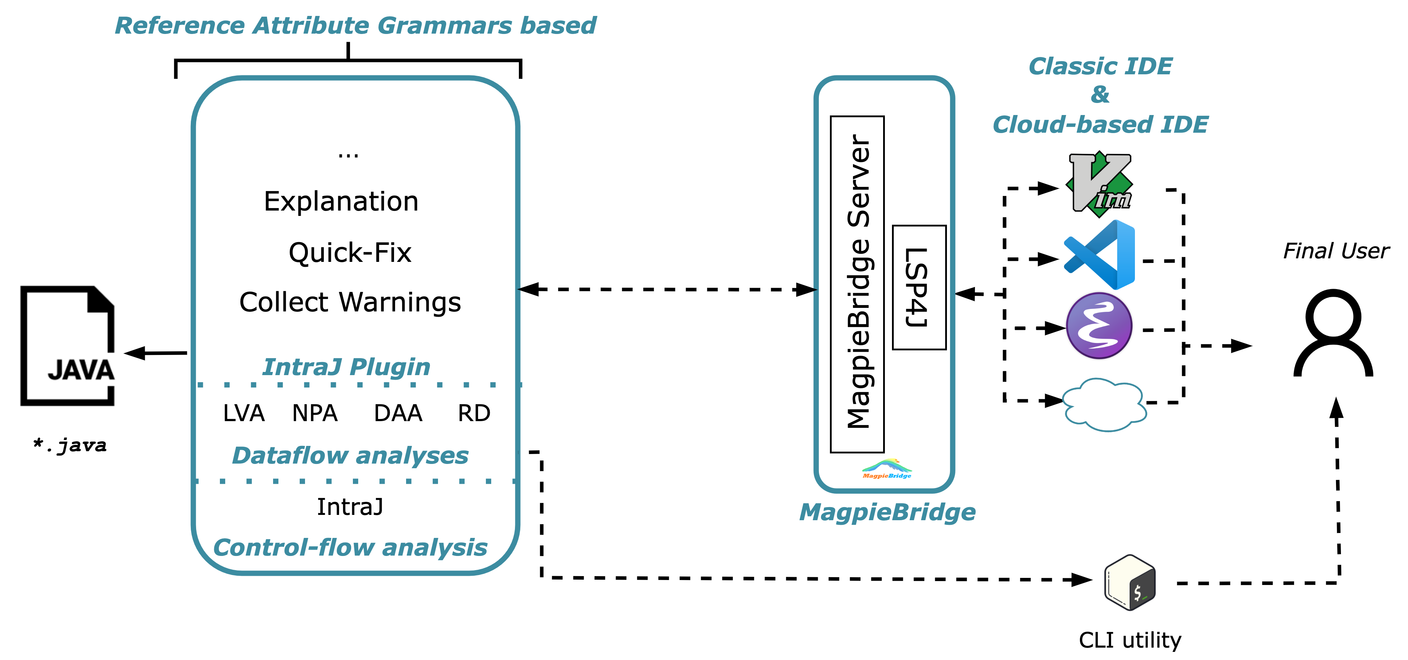
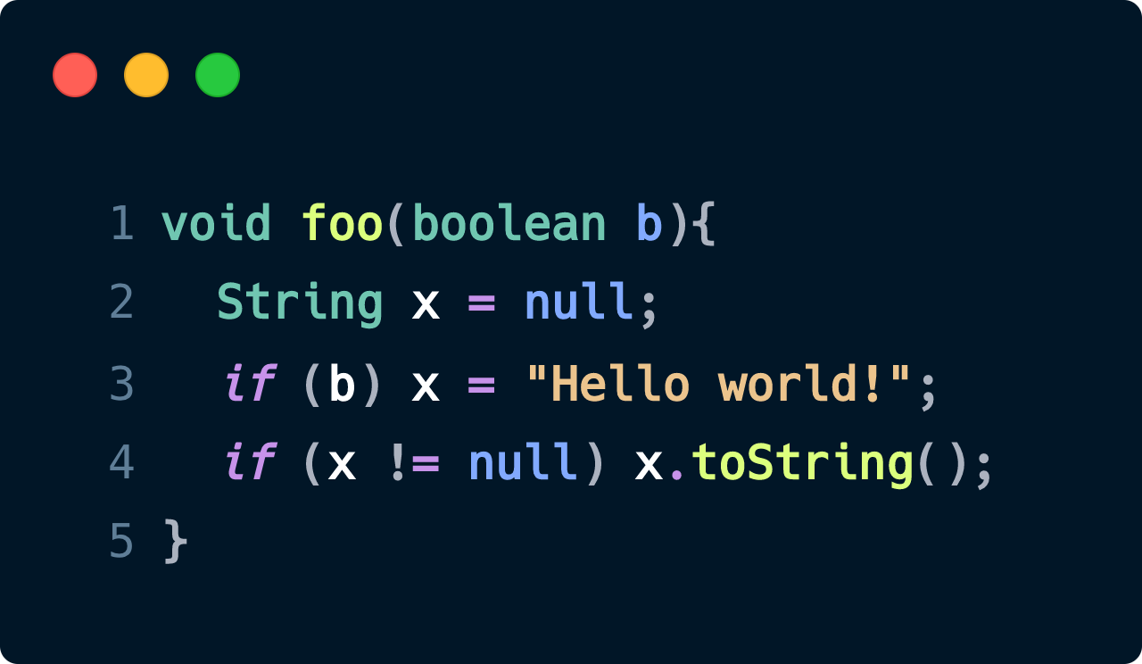





MOTIVaTIONs
Static program analysis plays a fundamental role in software development and helps developers to detect subtle bugs such as null pointer exceptions or security vulnerabilities.
In this poster, we present IntraJ: an instance of the IntraCFG framework that constructs precise intraprocedural control-flow graphs.
a precise framework for Source-level control-flow analysis
`
On-demand evaluation
Idriss riouak, Christoph reichenbach, Görel Hedin, and Niklas FOrs
Lund University, Sweden
advanced bug detection in your ide
experiments
We compared the precision and the performance of IntraJ against SonarQube by implementing two dataflow analyses:
Dead Assignment Analysis (DAA)
Null Pointer Analysis (NPA)
Our benchmarks:
No need to analyse the entire project. The analyses are computed only on open and dependent files.
33K LOC
49K LOC
95K LOC
97K LOC
ADVANCED BUG DETECTION REQUIRES CONTROL-FLOW AND DATAFLOW ANALYSES
FAST ANALYSES ARE REQUIRED FOR IDE INTEGRATION
specification
precision
THE CONTROL-FLOW GRAPH IS CONSTRUCTED ON TOP OF THE ABSTRACT SYNTAX TREE
ONLY RELEVANT NODES ARE INCLUDED IN THE ANALYSIS
Quick fact:
precise analyses results
Fully declarative specification using JastAdd2
Easy to support new language constructs
performance
Dead Assignment Analysis
Seconds
ConclusioNS
HIGH PRECISION
CONCISE SPECIFICATION
COMPETITIVE WITH SONARQUBE
LSP SUPPORT
SUPPORT FOR QUICK-FIXES AND BUG EXPLANATION.
Null-Pointer Analysis
Future work
INTERPROCEDURAL CFGs
BETTER SUPPORT FOR QUICK-FIX AND BUG EXPLANATION
Seconds
VSCode Extension
GitHub
Repository
IntraJ
Article
Quick Fact:
Overall faster than sonarqube
Notes:
Discuss Magpie Bridge

